Slide 1
Innovaluation Feasibility Presentation
Adam Winebarger
Kyle Smigelski
Lucas Myers

Slide 2
Content
Introduction
Tools
GitHub Repository Structure
System Organization
Development
Non-Trivial Requirements
Mockup
Work Policies
Testing
Special Considerations
Deliverance and Milestones

Slide 3
Introduction
Tuberculosis is the 13th leading cause of death in the world.
The Tuberculosis TST Test can determine whether or not somebody is infected with Tuberculosis - including latent Tuberculosis.
Many patients never return to get their diagnosis.
Our goal is to make it easier to get the diagnosis and therefore increase the number of patients who receive their diagnosis.
Innovaluation TST allows patients to photograph the test injection site on the first and third day. The application will run a ML model to determine the test results.

Slide 4
Tools
End-user application:
IDE: Android Studio
Flutter SDK
Dart
Backend:
Firebase - Cloud Firestore
Handles database, backend logic, general web-services
Languages: Javascript, possibly python
Machine Learning Components:
TBD
Possibly Tensorflow
More than likely python tools

Slide 5
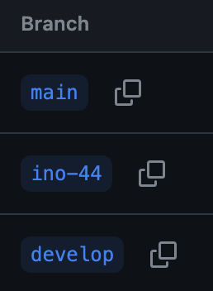
GitHub Repository Structure

Slide 6
System Organization
Client Side:
Users will first be greeted with a login/signup screen
Once logged in, main menu will show relevant TST information
Picture screen will allow end-user to take photo of TST site 48-72 hours after injection
May also allow users to snap initial photo as well (TBD)
Server Side:
Firebase will handle, the creation and management of users, as well as secure storage of user data
Push notification functionality will be implemented here, which will notify users when they are in that 48-72 hour window to take their follow-up photograph
ML tools will also be implemented here to determine whether a follow-up photo is positive for tuberculosis

Slide 7
Development
IDE: Android Studio
Version Control: github
Project Management: Jira
Communication: Discord & Zoom
Languages used: Dart, Javascript, possibly Python

Slide 8
Non-Trivial Requirements
End-user application
Developed in Flutter
Flutterfire & Google Auth integration
Possible additional 3rd party Flutter packages
Firebase
Cloud-Firestore for database
Firebase functions for push notifications
Google auth for user handling
ML Components (TBD)
Potentially Tensorflow

Slide 9
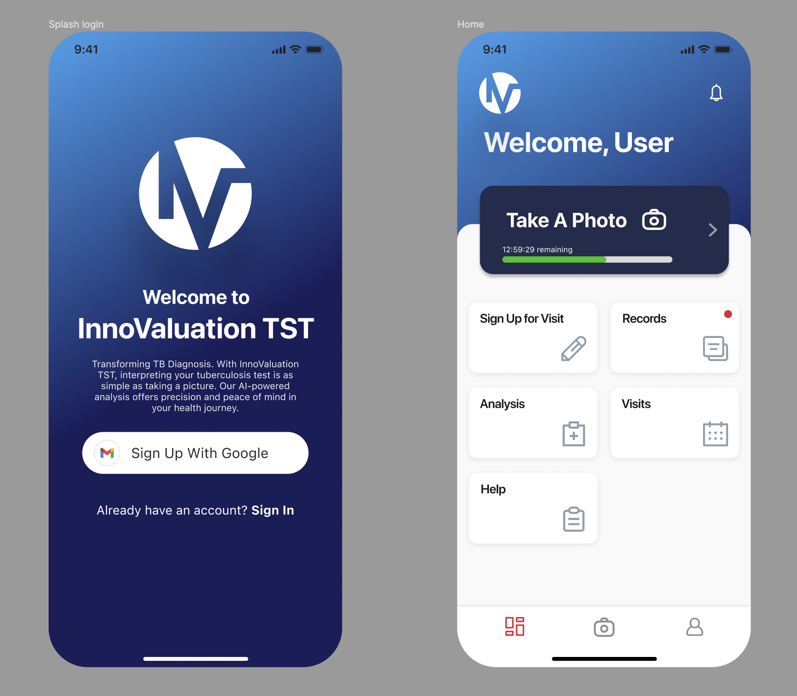
Mockup

Slide 10
Work Policies
Roles:
Administrative/Group Leader: Lucas Myers
Programming Lead: Adam Winebarger
UX/UI Lead: Kyle Smigelski
Resident ML Expert: Grant Alphenaar
What else?

Slide 11
Testing
Component Testing (As we go)
Changes made on different branches will be examined by lead-programmer prior to merging to master
Graphical changes will be inspected by lead UX/UI
Changes made by lead programmer will see secondary inspection
Baseline Application testing (Sprint 2/3)
ML Model Testing (Sprint 3/4/5)
System Testing (Sprint 5/6)

Slide 12
Special Considerations
Previous Studies
Synthetic Image Generation
Deliberately inducing False-positives
How to track growth-site delta
Lack of available training data

Slide 13
Deliverance & Milestones
Sprint 1
Focus on end-user side
Develop baseline app
Set up Cloud Firestore
Sprint 2
Finish Sprint 1 tasks
Greater research into ML specs
Potentially begin training ML model
Sprint 3
Integration of known ML tools
Training model in earnest
Sprint 4
Buffer sprint
Polish GUI
Bug hunt
Begin documentation
Sprint 5
Documentation
System Testing
Sprint 6
Presentation

Slide 14
Thank You!

